Slide 1

CERTIFICATE III IN AUTOMOTIVE REPAIR & MAINTENANCE
SUBJECT: VEHICLE MAINTENACE AND REPAIR
By Ibrahim siraj
Maldives polytechnic

Slide 2
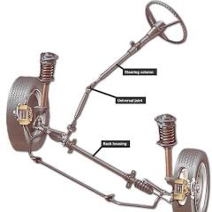
VEHICLE MAINTENACE AND REPAIR
Chapter 9 Inspection and Service Steering System Components
Introduction
A steering system is the mechanism in a vehicle that converts the driver's rotational input from the steering wheel into the swiveling motion of the wheels to change the vehicle's direction
A swiveling motion is a type of rotation or turning movement around a central point or axis, allowing an object or a body part to face in a different direction
The basic components include the steering wheel, steering column, and a steering gear (like a rack and pinion or recirculating ball) that is connected to the wheels via a linkage system of rods and joints. The system is designed to provide the driver with effortless control and a sense of the road while allowing for safe maneuvering
By Ibrahim siraj
Maldives polytechnic

Slide 3
VEHICLE MAINTENACE AND REPAIR
Chapter 9 Inspection and Service Steering System Components
Steering Function
Directional control: The primary function is to change the direction of a vehicle by turning the wheels, most commonly the front ones.
Force conversion: It transforms the rotational movement of the steering wheel into the linear motion needed to turn the wheels, making it easier for the driver to steer even a heavy vehicle.
Road feedback and stability: The system provides the driver with feedback from the road surface and helps maintain directional stability, returning the wheels to a straight position after a turn.
Safety: It includes safety features, such as collapsible steering columns to protect the driver in a crash, and is designed to be precise with minimal play
By Ibrahim siraj
Maldives polytechnic

Slide 4
VEHICLE MAINTENACE AND REPAIR
Chapter 9 Inspection and Service Steering System Components
Common Components
Steering wheel: The part the driver holds and turns.
Steering column: Connects the steering wheel to the steering gear, often containing universal joints and collapsible features for safety.
Steering gear: The mechanism that converts the rotary motion of the steering wheel into linear motion. Common types are rack and pinion and recirculating ball.
Linkage: A series of rods, arms, and tie rods that connect the steering gear to the steering knuckles on the wheels, transmitting the movement to turn them
By Ibrahim siraj
Maldives polytechnic

Slide 5
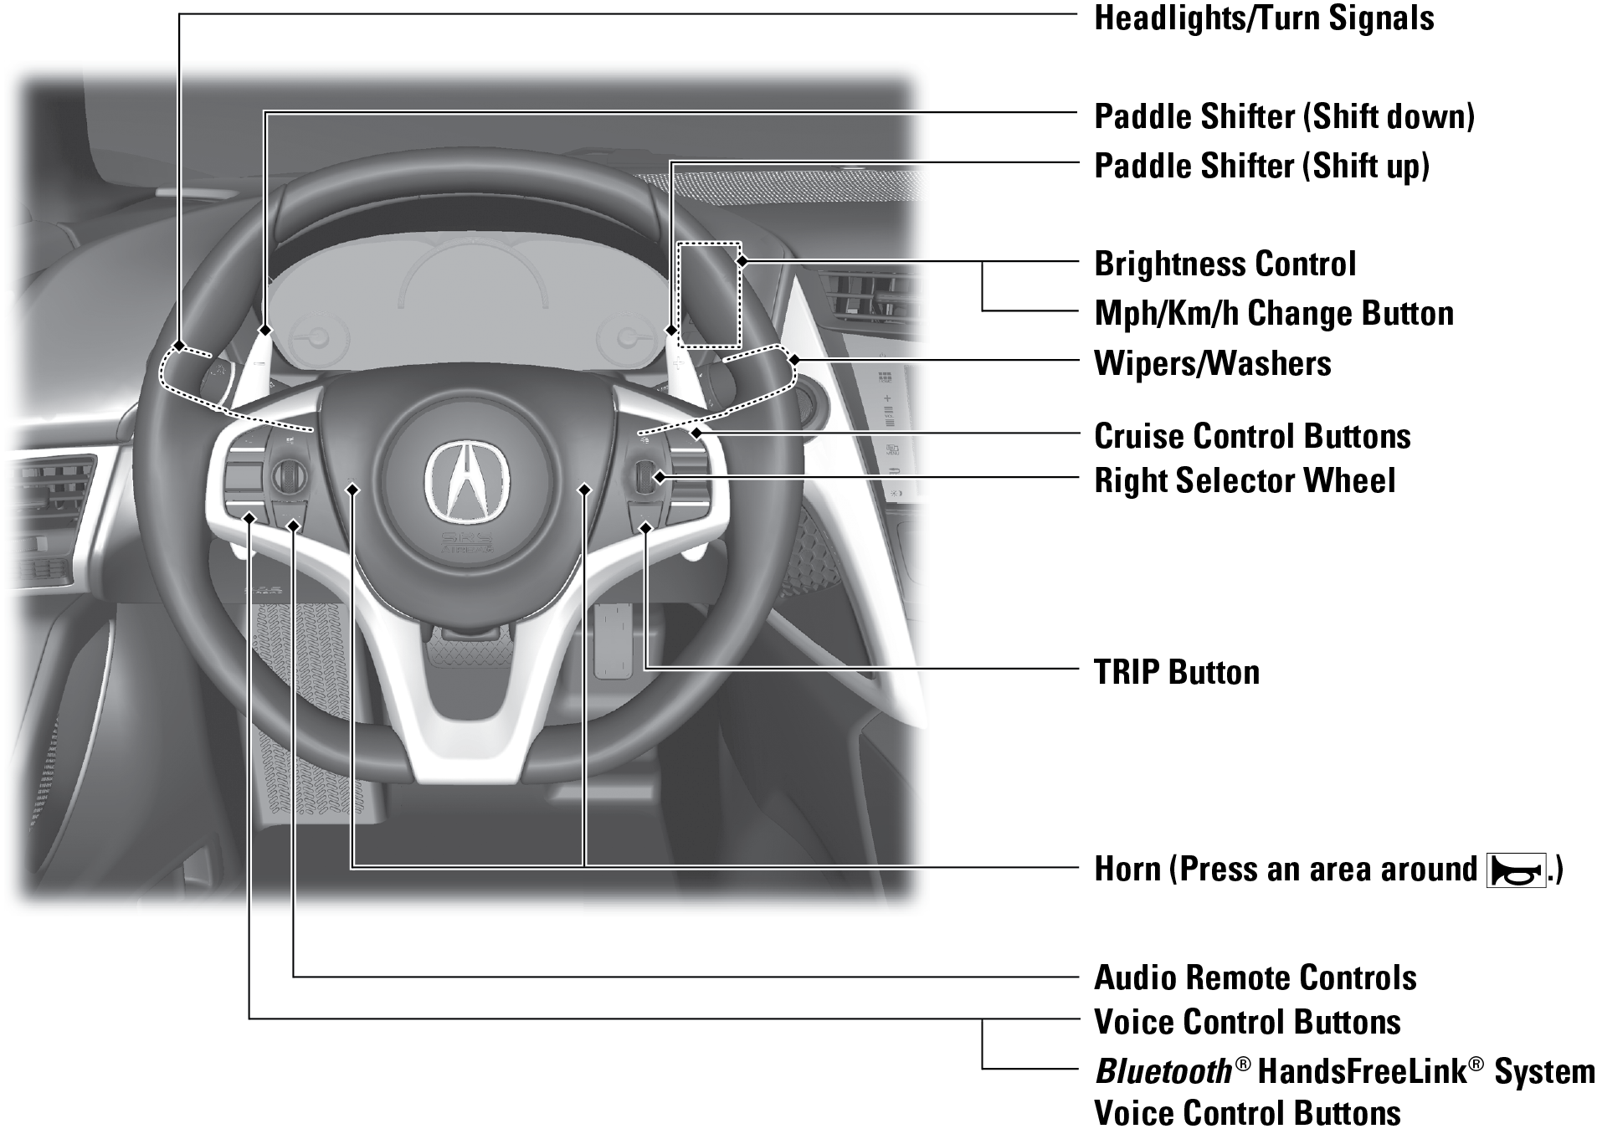
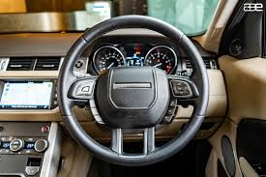
VEHICLE MAINTENACE AND REPAIR
Chapter 9 Inspection and Service Steering System Components
Common Components
Steering wheel: The part the driver holds and turns.
Components and Features
Modern steering wheels are sophisticated control hubs with many integrated features designed for safety, comfort, and convenience. Key components include:
By Ibrahim siraj
Maldives polytechnic

Slide 6
VEHICLE MAINTENACE AND REPAIR
Chapter 9 Inspection and Service Steering System Components
Common Components
Steering column: Connects the steering wheel to the steering gear, often containing universal joints and collapsible features for safety.
It is a crucial link between the driver's input and the vehicle's wheels, and it also houses components like the turn signal switch and can include a collapsible safety feature for collision
Connection: The steering column houses a steering shaft that runs from the steering wheel at the top to the steering gear (like a rack and pinion) at the bottom.
Function: It translates the rotational movement of the steering wheel into the directional movement of the wheels.
Components: It can also contain other parts, such as the turn signal switch, which uses a cam to activate and cancel the signal.
Safety: Modern steering columns are designed with a safety feature that allows them to collapse in a frontal impact, which helps prevent serious injury to the driver.
Adjustability: Some steering columns can be adjusted to allow the driver to change the tilt or height of the steering wheel for a more comfortable driving position
By Ibrahim siraj
Maldives polytechnic

Slide 7
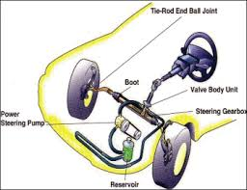
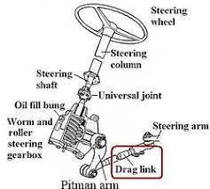
VEHICLE MAINTENACE AND REPAIR
Chapter 9 Inspection and Service Steering System Components
Common Components
Steering column: Connects the steering wheel to the steering gear, often containing universal joints and collapsible features for safety.
By Ibrahim siraj
Maldives polytechnic

Slide 8
VEHICLE MAINTENACE AND REPAIR
Chapter 9 Inspection and Service Steering System Components
Function Components
Steering shaft: The shaft runs through the column and is the main component for transmitting motion from the steering wheel to the steering gear.
Steering gear: The shaft connects to the steering gear (either a rack and pinion or steering box) at the other end, which converts the rotational motion into the linear movement of the wheels.
Housing: The column is a tube-like housing that protects the steering shaft and often contains other components.
Universal joints: These joints allow the column to deviate from a straight line, which helps position the steering wheel correctly for the driver.
Safety features: In a collision, the column is designed to collapse to prevent it from impaling the drive
Controls: The steering column assembly houses various controls, including turn signal switches and, in some models, the ignition.
Tilt adjustment: Many steering columns have a tilt adjustment, which allows the driver to change the angle of the steering wheel for comfort
By Ibrahim siraj
Maldives polytechnic

Slide 9
VEHICLE MAINTENACE AND REPAIR
Chapter 9 Inspection and Service Steering System Components
Common Components
Steering gear: The mechanism that converts the rotary motion of the steering wheel into linear motion. Common types are rack and pinion and recirculating ball.
It is the central part of the steering system, providing mechanical advantage so the driver can steer with less effort. The most common type of steering gear is the rack-and-pinion system
How it works
Converts motion: The steering gear's primary function is to change the steering wheel's circular motion into the side-to-side movement of the wheels.
Provides leverage: It multiplies the driver's input, making it easier to turn the wheels, especially when a car is stationary or moving at low speeds.
Connects to wheels: The steering gear transmits this motion to the front wheels via a series of linkage components, such as tie rods
By Ibrahim siraj
Maldives polytechnic

Slide 10
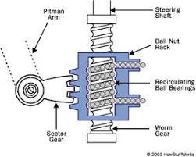
VEHICLE MAINTENACE AND REPAIR
Chapter 9 Inspection and Service Steering System Components
Common Components
Steering gear: The mechanism that converts the rotary motion of the steering wheel into linear motion. Common types are rack and pinion and recirculating ball.
Common types of steering gears
Rack-and-pinion: This is the most common type in modern cars and is known for being direct and precise. It uses a pinion gear at the end of the steering column that meshes with a toothed rack. When the steering wheel turns, the pinion moves the rack left or right.
Recirculating ball: This older system is often found in larger vehicles like trucks and some older cars. It uses a worm gear connected to the steering column that turns a sector gear. Ball bearings are used to reduce friction between the worm and the gear
By Ibrahim siraj
Maldives polytechnic

Slide 11
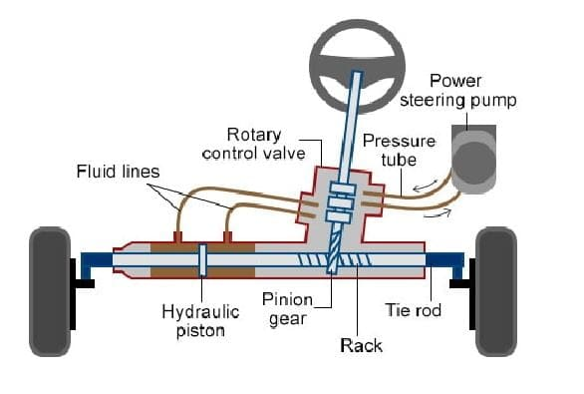
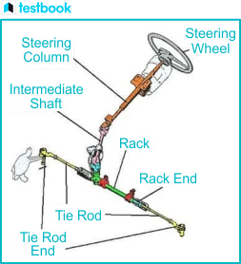
VEHICLE MAINTENACE AND REPAIR
Chapter 9 Inspection and Service Steering System Components
Common Components
Rack-and-pinion: This is the most common type in modern cars and is known for being direct and precise. It uses a pinion gear at the end of the steering column that meshes with a toothed rack. When the steering wheel turns, the pinion moves the rack left or right.
By Ibrahim siraj
Maldives polytechnic

Slide 12
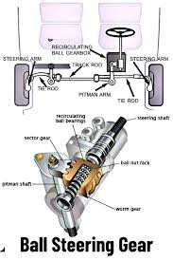
VEHICLE MAINTENACE AND REPAIR
Chapter 9 Inspection and Service Steering System Components
Common Components
Recirculating ball: This older system is often found in larger vehicles like trucks and some older cars. It uses a worm gear connected to the steering column that turns a sector gear. Ball bearings are used to reduce friction between the worm and the gear
By Ibrahim siraj
Maldives polytechnic

Slide 13
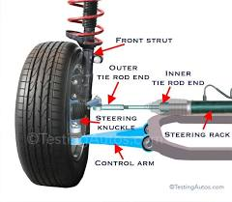
VEHICLE MAINTENACE AND REPAIR
Chapter 9 Inspection and Service Steering System Components
Common Components
Linkage: A series of rods, arms, and tie rods that connect the steering gear to the steering knuckles on the wheels, transmitting the movement to turn them
It is a critical part of the steering system, made up of various rods, levers, and joints like the tie rods, ball joints, and arms, which translate the driver's steering wheel input into directional movement of the wheels
By Ibrahim siraj
Maldives polytechnic

Slide 14
VEHICLE MAINTENACE AND REPAIR
Chapter 9 Inspection and Service Steering System Components
Common Components
Linkage: A series of rods, arms, and tie rods that connect the steering gear to the steering knuckles on the wheels, transmitting the movement to turn them
Key components
Tie rods: Connect the steering gear to the steering arms on the wheels. They are often connected to the steering arms by tie rod ends, which have a ball joint-like socket.
Ball joints: Allow the wheels to move up and down while pivoting in different directions.
Control arms: Part of the suspension that connects the wheels to the vehicle's body.
Steering arms: Attached to the steering knuckles, these arms pivot the wheels when they are pushed or pulled by the linkage.
Pitman arm, idler arm, and center link: These components are part of the older "parallelogram" steering system, which uses a series of arms and rods to transfer motion to the wheel
By Ibrahim siraj
Maldives polytechnic

Slide 15
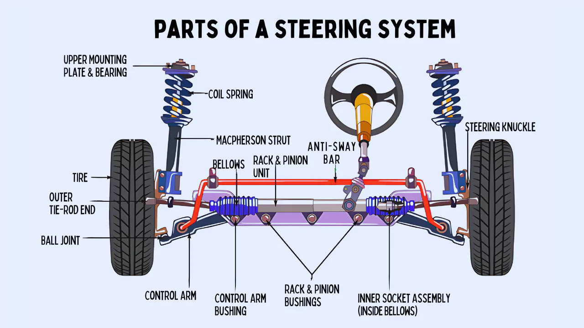
VEHICLE MAINTENACE AND REPAIR
Chapter 9 Inspection and Service Steering System Components
Common Components
Linkage: A series of rods, arms, and tie rods that connect the steering gear to the steering knuckles on the wheels, transmitting the movement to turn them
Key components
By Ibrahim siraj
Maldives polytechnic

Slide 16
VEHICLE MAINTENACE AND REPAIR
Chapter 9 Inspection and Service Steering System Components
Common Components
Linkage: A series of rods, arms, and tie rods that connect the steering gear to the steering knuckles on the wheels, transmitting the movement to turn them
How it works
When the driver turns the steering wheel, the motion is sent to the steering gear.
2. The steering gear pushes or pulls on the linkage, causing parts like the tie rods to move.
3. This movement is transferred through the linkage to the steering arms on the wheels, which pivots them left or right.
4. The linkage is designed with pivot points, like ball joints, to allow the wheels to move up and down over the road while still turning correctly
By Ibrahim siraj
Maldives polytechnic

Slide 17
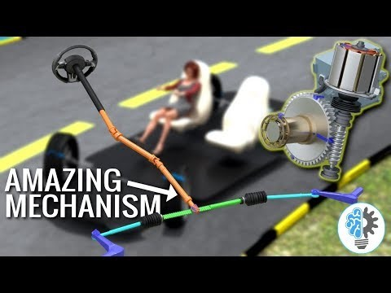
VEHICLE MAINTENACE AND REPAIR
Chapter 9 Inspection and Service Steering System Components
Common Components
Linkage: A series of rods, arms, and tie rods that connect the steering gear to the steering knuckles on the wheels, transmitting the movement to turn them
How it works
By Ibrahim siraj
Maldives polytechnic

Slide 18
VEHICLE MAINTENACE AND REPAIR
Chapter 9 Inspection and Service Steering System Components
Power Steering Types
Vehicles use power steering systems, either hydraulic or electric, to assist the driver, or other specialized systems like four-wheel steering or steer-by-wire for enhanced maneuverability or advanced control
Hydraulic Power Steering (HPS): An engine-driven pump creates hydraulic pressure to help the driver turn the wheel. This system is common in older vehicles but requires the pump to run constantly
Electric Power Steering (EPS): A motor provides assistance, but only when the steering wheel is turned, making it more efficient
Pros: More fuel-efficient, allows for variable assistance based on speed, and doesn't have the risk of hydraulic fluid leaks
Steer-by-Wire: A high-tech system where the steering wheel is not mechanically linked to the wheels. It uses electronic signals to control the wheels, but the mechanical linkage is still used as a fail-safe in most road-legal vehicle
By Ibrahim siraj
Maldives polytechnic

Slide 19
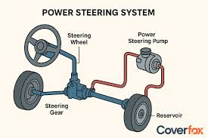
VEHICLE MAINTENACE AND REPAIR
Chapter 9 Inspection and Service Steering System Components
Power Steering Types
Other systems
Four-Wheel Steering: Steers both the front and rear wheels to improve maneuverability at low speeds and stability at high speeds.
Manual Steering: The driver provides all the force to turn the wheels without any power assistance. This is a simple and direct system, but requires significant physical effort
By Ibrahim siraj
Maldives polytechnic

Slide 20
VEHICLE MAINTENACE AND REPAIR
Chapter 9 Inspection and Service Steering System Components
Hydraulic Power Steering (HPS): An engine-driven pump creates hydraulic pressure to help the driver turn the wheel. This system is common in older vehicles but requires the pump to run constantly
A hydraulic power steering system uses a belt-driven pump to pressurize hydraulic fluid, which is then directed by a rotary valve to a cylinder that helps move the steering rack, making steering lighter and more responsive
This system provides variable assistance, delivering more support at low speeds and less at higher speeds, though it also has drawbacks like reduced fuel efficiency and the need for regular maintenance
How it works
Pump: An engine-driven pump pressurizes power steering fluid. The pump's speed is directly tied to the engine's speed, so higher engine RPMs mean more hydraulic pressure.
Valve: When the driver turns the steering wheel, a rotary valve is activated. This valve directs the high-pressure fluid to one side of a hydraulic cylinder.
Cylinder: The pressurized fluid moves a piston inside the cylinder, which is attached to the steering rack. This hydraulic force assists the physical effort required to turn the wheels.
By Ibrahim siraj
Maldives polytechnic

Slide 21
VEHICLE MAINTENACE AND REPAIR
Chapter 9 Inspection and Service Steering System Components
Hydraulic Power Steering (HPS): An engine-driven pump creates hydraulic pressure to help the driver turn the wheel. This system is common in older vehicles but requires the pump to run constantly
How it works
Assistance: The system provides more assistance at low speeds (e.g., parking) for easier steering and less assistance at high speeds for better control. The valve returns some fluid to the reservoir to prevent the steering from feeling too sensitive at high speeds.
Fluid flow: After the fluid has pushed the piston, it returns to the reservoir in a continuous cycle
Advantages
Responsive and light steering: Provides significant assistance, especially at low speeds, making the vehicle easier to maneuver.
Proven technology: It is a long-established and robust system.
Disadvantages
Fuel efficiency: The engine is constantly working to power the hydraulic pump, which can negatively impact fuel economy.
Maintenance: Requires regular maintenance, including checking and replacing the hydraulic fluid.
Complexity: Has more components than some newer electric power steering systems
By Ibrahim siraj
Maldives polytechnic

Slide 22
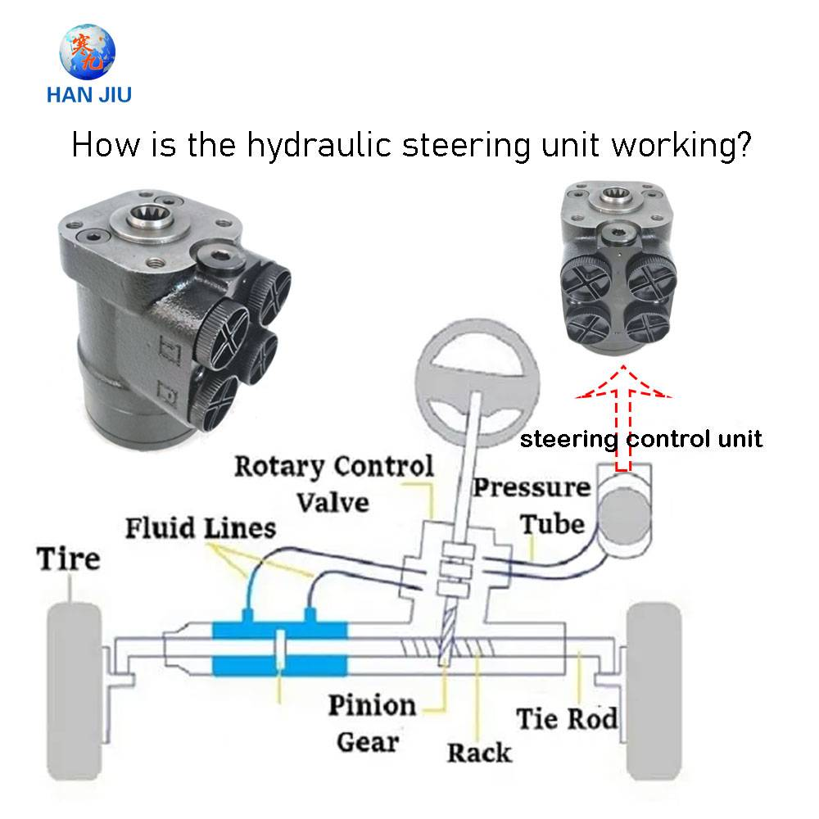
VEHICLE MAINTENACE AND REPAIR
Chapter 9 Inspection and Service Steering System Components
Hydraulic Power Steering (HPS): An engine-driven pump creates hydraulic pressure to help the driver turn the wheel. This system is common in older vehicles but requires the pump to run constantly
How it works
By Ibrahim siraj
Maldives polytechnic

Slide 23
VEHICLE MAINTENACE AND REPAIR
Chapter 9 Inspection and Service Steering System Components
Electric Power Steering (EPS): A motor provides assistance, but only when the steering wheel is turned, making it more efficient
Electric Power Steering (EPS) uses an electric motor to assist the driver's steering effort, unlike hydraulic systems that use a pump and fluid. This system is more energy-efficient because the motor only draws power when the driver is steering and allows for customizable steering feel. Key components include an electronic control unit (ECU), a torque sensor to measure driver input, and a steering angle sensor
How it works
Steering input: When the driver turns the steering wheel, a torque sensor detects the force being applied.
ECU processing: The electronic control unit (ECU) receives signals from the torque sensor and a vehicle speed sensor.
Motor assistance: Based on the driver's input and vehicle speed, the ECU tells the electric motor how much assistance to provide to help turn the wheels.
Variable assist: The amount of assistance changes with speed, making it easier to maneuver at low speeds (like parking) and providing more resistance for stability at high speeds
By Ibrahim siraj
Maldives polytechnic

Slide 24
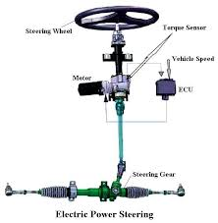
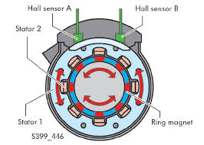
VEHICLE MAINTENACE AND REPAIR
Chapter 9 Inspection and Service Steering System Components
Electric Power Steering (EPS): A motor provides assistance, but only when the steering wheel is turned, making it more efficient
Components
Electric motor: Provides the rotational force to assist the steering.
Electronic Control Unit (ECU): The "brain" of the system that reads sensor data and controls the motor.
Torque sensor: Measures the force the driver applies to the steering wheel.
Steering angle sensor: Monitors the position and rotation of the steering wheel.
Reduction gear: Works with the motor to help turn the steering rack's gear
By Ibrahim siraj
Maldives polytechnic

Slide 25
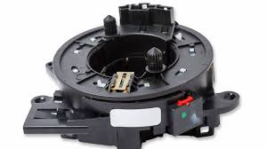
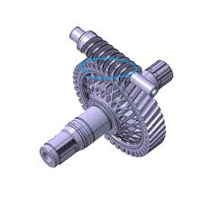
VEHICLE MAINTENACE AND REPAIR
Chapter 9 Inspection and Service Steering System Components
Electric Power Steering (EPS): A motor provides assistance, but only when the steering wheel is turned, making it more efficient
Components
Electric motor: Provides the rotational force to assist the steering.
Electronic Control Unit (ECU): The "brain" of the system that reads sensor data and controls the motor.
Torque sensor: Measures the force the driver applies to the steering wheel.
Steering angle sensor: Monitors the position and rotation of the steering wheel.
Reduction gear: Works with the motor to help turn the steering rack's gear
Steering angle sensor
By Ibrahim siraj
Maldives polytechnic

Slide 26
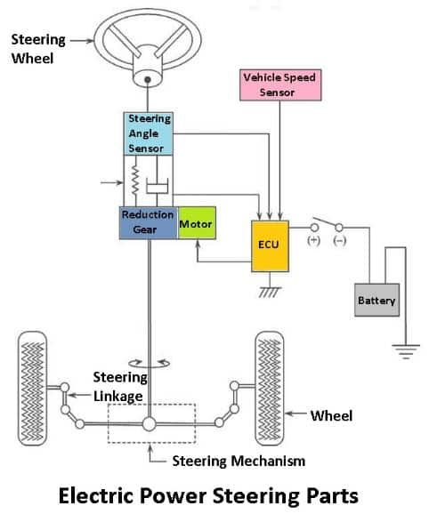
VEHICLE MAINTENACE AND REPAIR
Chapter 9 Inspection and Service Steering System Components
Electrical steering system
The Electronic Control Module (ECM) in an electric steering system (also known as the EPS Control Module or ECU) acts as the system's "brain". Its primary function is to calculate and provide the precise amount of steering assistance needed at any given moment, based on data from various sensors and other vehicle systems
By Ibrahim siraj
Maldives polytechnic

Slide 27
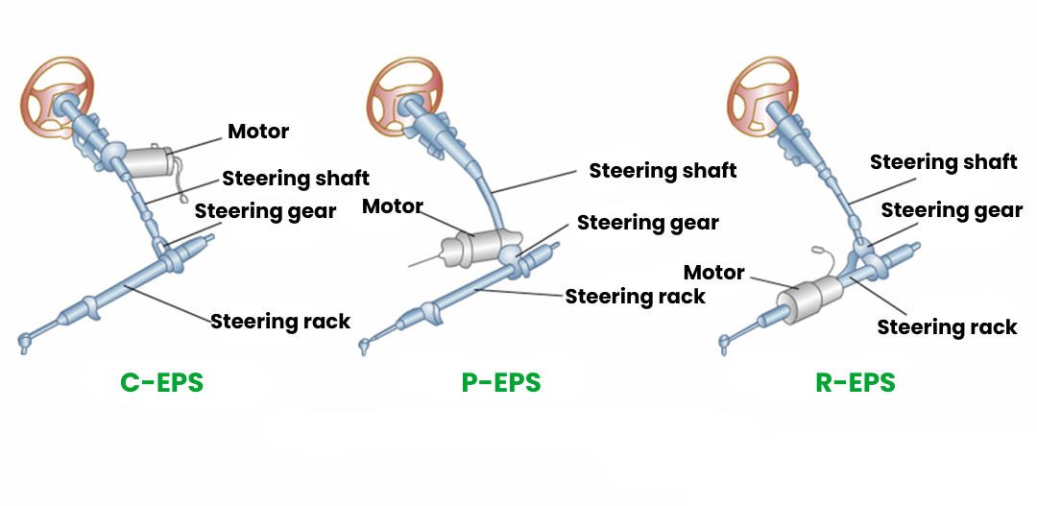
VEHICLE MAINTENACE AND REPAIR
Chapter 9 Inspection and Service Steering System Components
Electrical steering system
By Ibrahim siraj
Maldives polytechnic

Slide 28
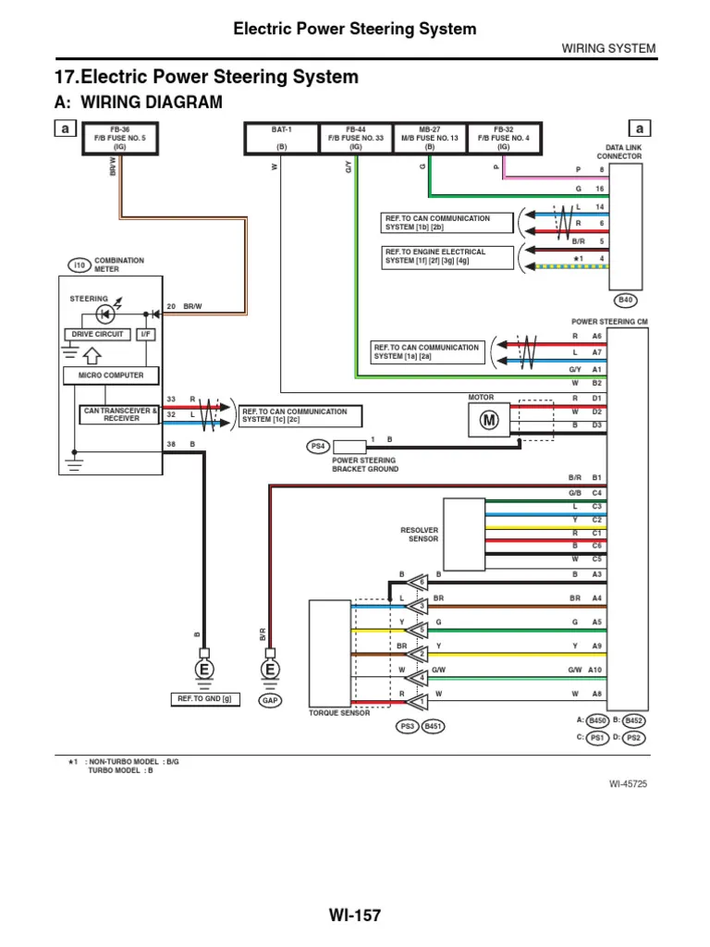
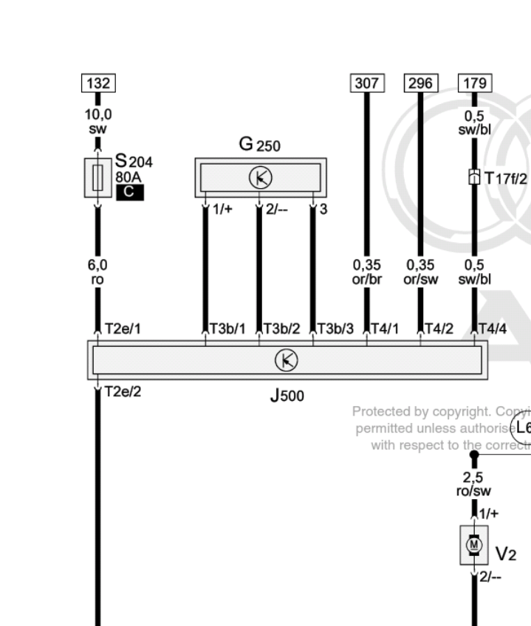
VEHICLE MAINTENACE AND REPAIR
Chapter 9 Inspection and Service Steering System Components
Electrical steering system
By Ibrahim siraj
Maldives polytechnic

Slide 29
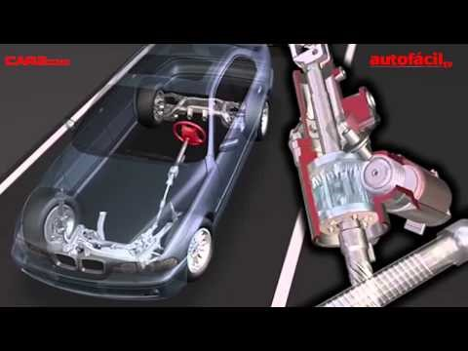
VEHICLE MAINTENACE AND REPAIR
Chapter 9 Inspection and Service Steering System Components
Electrical steering system
By Ibrahim siraj
Maldives polytechnic

Slide 30
THANK YOU

